Slide 1
Casting vegetables and fruits in plaster of Paris
https://youtu.be/-XkGExlLQrs

Slide 2
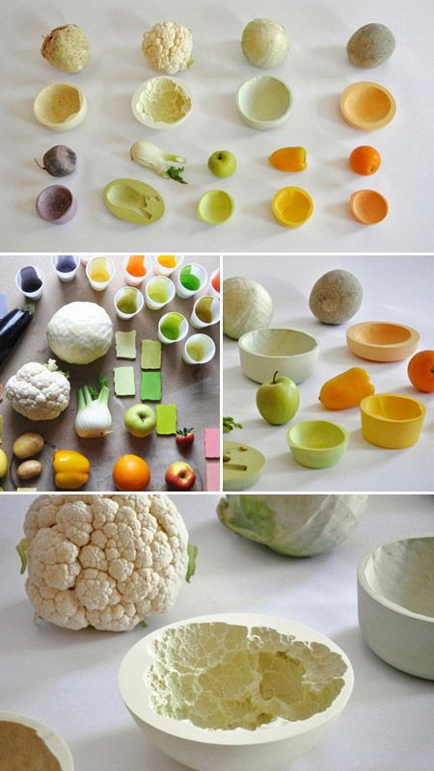

Slide 3
Click at the given link
https://youtu.be/-XkGExlLQrs

Slide 4
Backward Bowls: From Form-Cast Fruit to Inverted Veggies
From potatoes, peppers and onions to pears, apples and oranges, we take the unique organic forms of
fruits and vegetables for granted when we pick them up at the grocery store or slice them for a meal – these bowls, by comparison, are creative food-for-thought pieces that leave a new, unique and lasting impression.

Slide 5
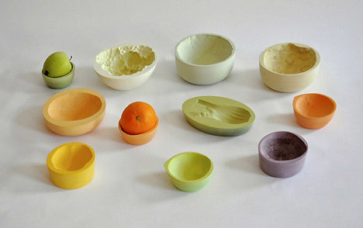

Slide 6
Requiring no firing, these powdered-ceramic creations from Mischer’Traxler (via Dezeen)are as naturally unique as each fruit or vegetable that went into making them. The works individually reflect the embedded organic form of the objects pressed into them and their identities are reinforced by dyes added before the pressing and drying processes.

Slide 7
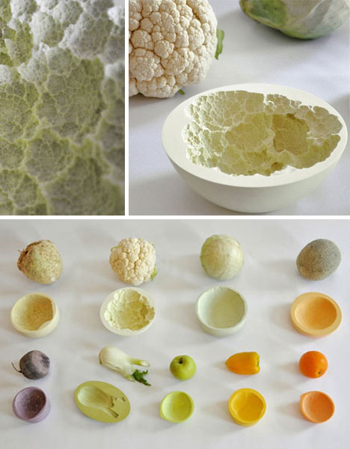

Slide 8
Each piece casts a new light on the plant matter that made it possible, from the smooth shapes and surface textures of citrus fruits to the rough and variegated and complex fractal patterns of cauliflower and everything in between. Because they do not need to be fired, they can hold the shapes of otherwise heat-sensitive source materials

Slide 9
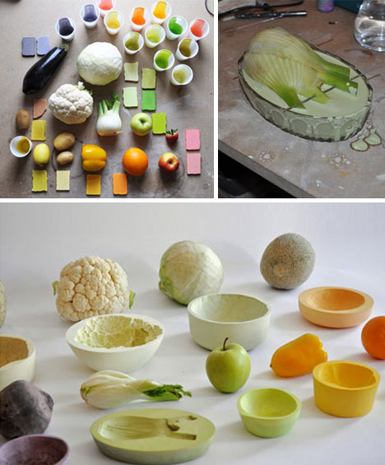

Slide 10
Each piece casts a new light on the plant matter that made it possible, from the smooth shapes and surface textures of citrus fruits to the rough and variegated and complex fractal patterns of cauliflower and everything in between. Because they do not need to be fired, they can hold the shapes of otherwise heat-sensitive source materials

